Slide 1
Predicting Game Play Direction in Football Videos
Amit Bawaskar, Michael Lam
CS 534 Final Project
June 12, 2013

Slide 2
Outline
Problem Statement
Overview of Approach
KLT Tracks
Machine Learning Formulation
Experiments and Results
Conclusion

Slide 3
Problem Statement
Given a video of a football game, predict the direction of the offensive play.
(video here)

Slide 4
Overview of Approach
If we can track the wide receiver(s), then we can predict the direction of offensive play.
(same video here)

Slide 5
Overview of Approach
Extract KLT tracks from video
Get useful statistics from tracks:
length, distance from edge of field, direction
Assemble features for machine learning algorithms: AdaBoost and decision tree
Train, test and evaluate

Slide 6
KLT Tracks
Extract KLT tracks from video frames:
(video with KLT tracks here)

Slide 7
KLT Tracks
Extract KLT tracks from video frames:
(video with KLT tracks here)

Slide 8
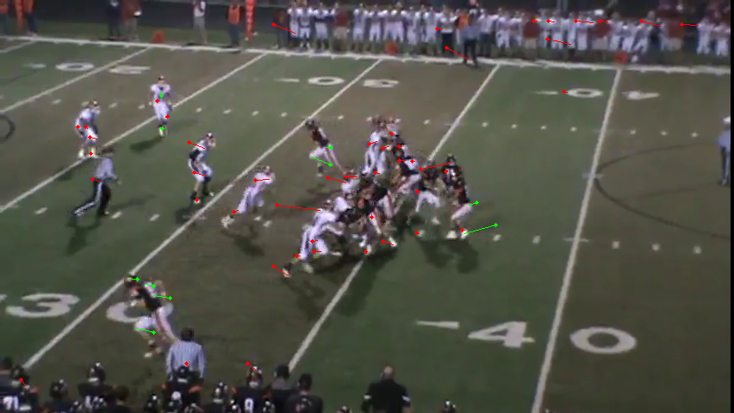
KLT Tracks
Extract KLT tracks from video frames:

Slide 9
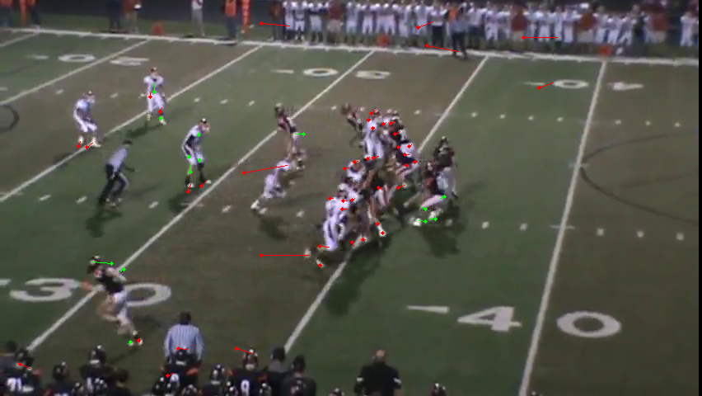
KLT Tracks
Extract KLT tracks from video frames:

Slide 10
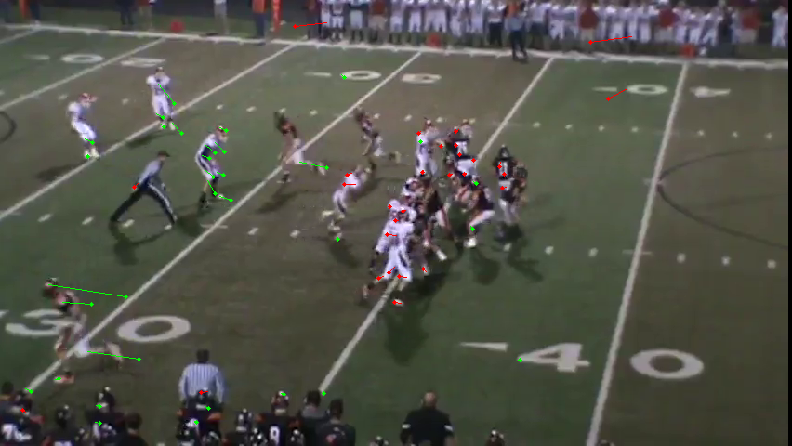
KLT Tracks
Extract KLT tracks from video frames:

Slide 11
KLT Tracks
Useful statistics:
1. Length of track:
Wide receiver rushes down field so longer tracks
2. Distance from the edge of the field:
Wide receiver is near the edge of field
3. Track direction with respect to the field:
Used for voting later

Slide 12
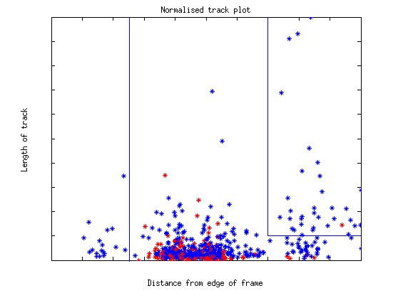
KLT Tracks
Plot these statistics (for a given video)
Rectangles contain tracks from wide receivers

Slide 13
Learning Regions
These rectangles are different per video due to variations in orientation, gameplay, quality, etc.
Therefore we want to learn the region that would contain the wide receiver, given training videos.
How do we learn this region?

Slide 14
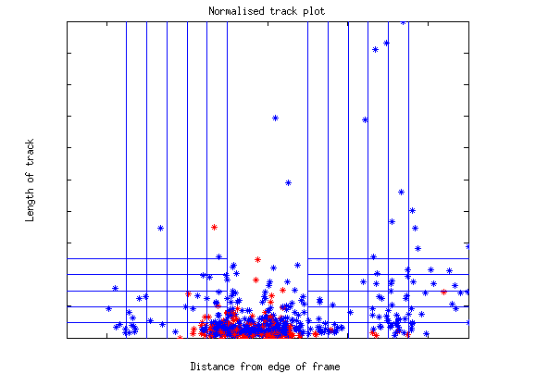
Our Approach
Construct 60 fixed regions across all videos and vote in each region. These are the features.
Learn a linear combination of these regions. In other words, learn the weights for weighted voting.

Slide 15
Learning Algorithms
AdaBoost with Decision Stumps
Learn a linear combination of weak classifiers
Most natural for our formulation of features
Decision Tree
Learn with information gain
Threshold continuous features
When to stop growing the tree?
Just another approach to compare with boosting

Slide 16
Experimental Setup
Our dataset consists of 314 football videos
Randomly partition videos into 75% training set, 25% test set
Train and test with AdaBoost as a function of ensemble size
Train and test with Decision Tree as a function of the maximum depth size

Slide 17
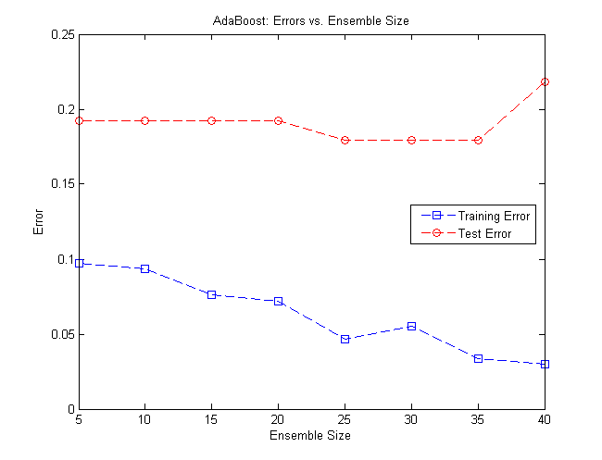
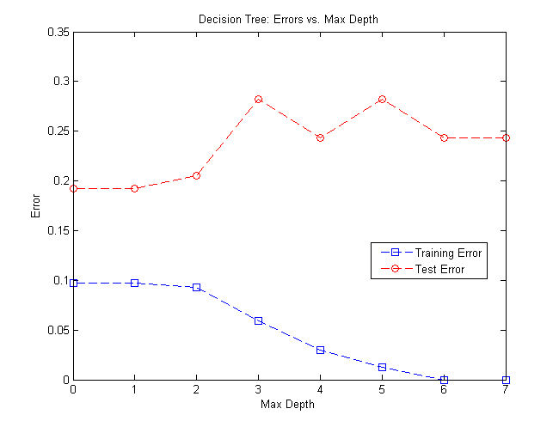
Results
Boosting works better than decision tree
82% generalization accuracy using boosting

Slide 18
Conclusion
Goal is to predict offensive play direction
Method:
Extract KLT Tracks
Form features
Use boosting and decision tree
Result: 82% accuracy with boosting
Our system is usable

Slide 19
Thank You
Acknowledgements:
Dr. Alan Fern
Dr. Sinisa Todorovic
Dr. Xiaoli Fern
Thank you for your time!

